Slide 1
Efficient ways for snow removing — city of syracuse
Qiyi Wu Prasan Krishnan Karthikeyan
Qi Long Mathey-Apossan Akuete Giana

Slide 2

Goals of our group
Allocate plowing areas to truck
Increase plowing efficiency
Reduce fuel cost

Slide 3
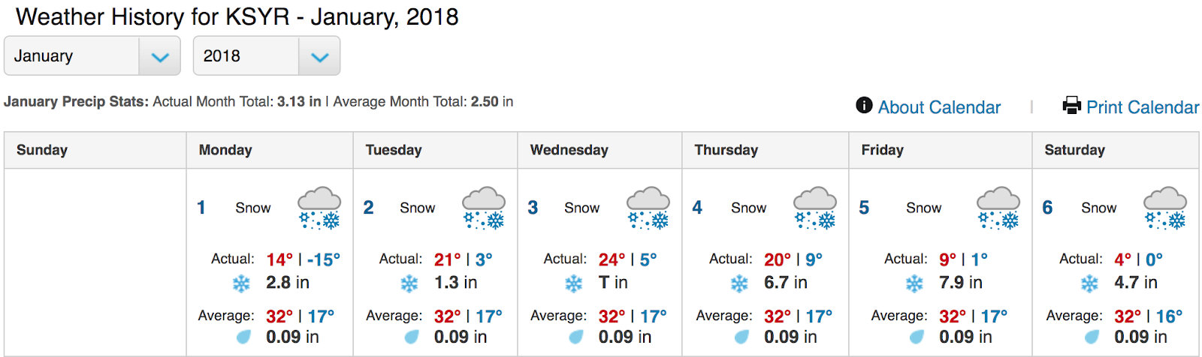
DATASETs we choose
Weather of Syracuse – Jan, 2018
Higher snow precipitation
4th of January, 2018
6th of January, 2018

Slide 4
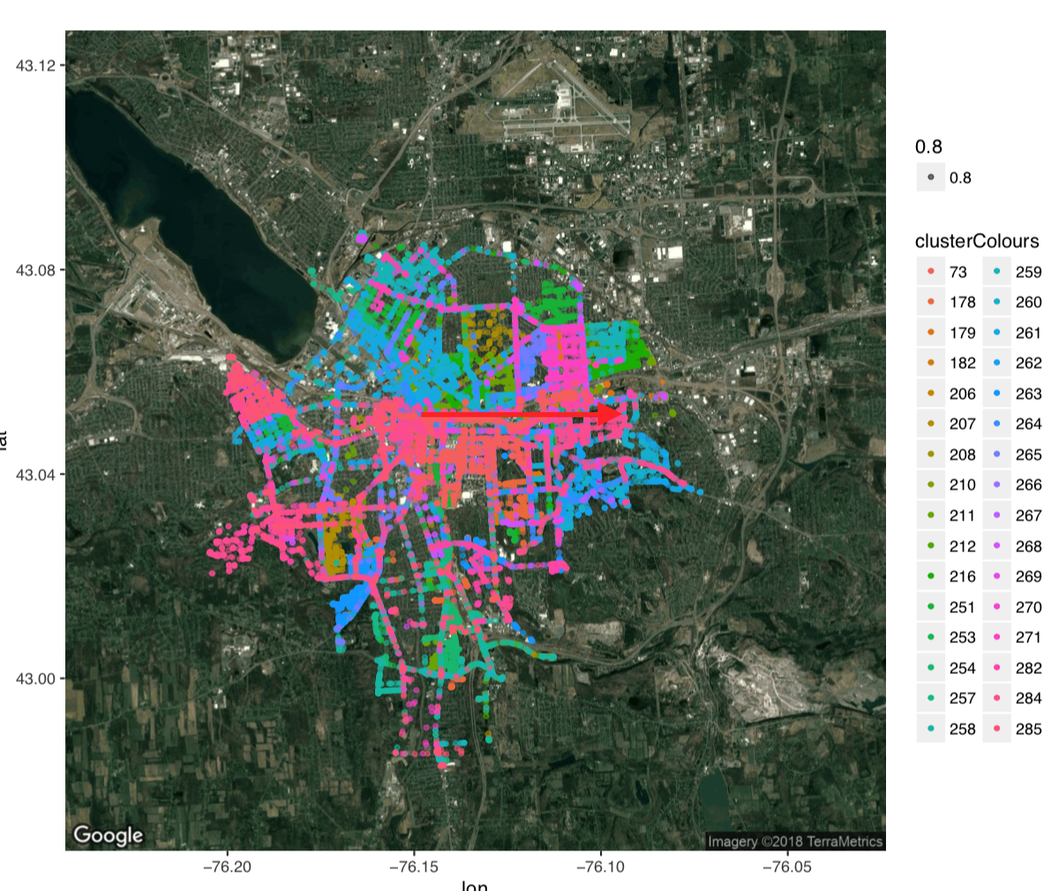
Problems we found
1
Overlap on truck activity
2
Trucks wander

Slide 5
solutions we provide
1
Cluster the truck movement
2
Allocate each truck at a given cluster area
3
Increase plowing efficiency & reduce fuel consumption
4
Minimize the overlap of truck movement
5
Drivers take shifts based on timings for each truck

Slide 6
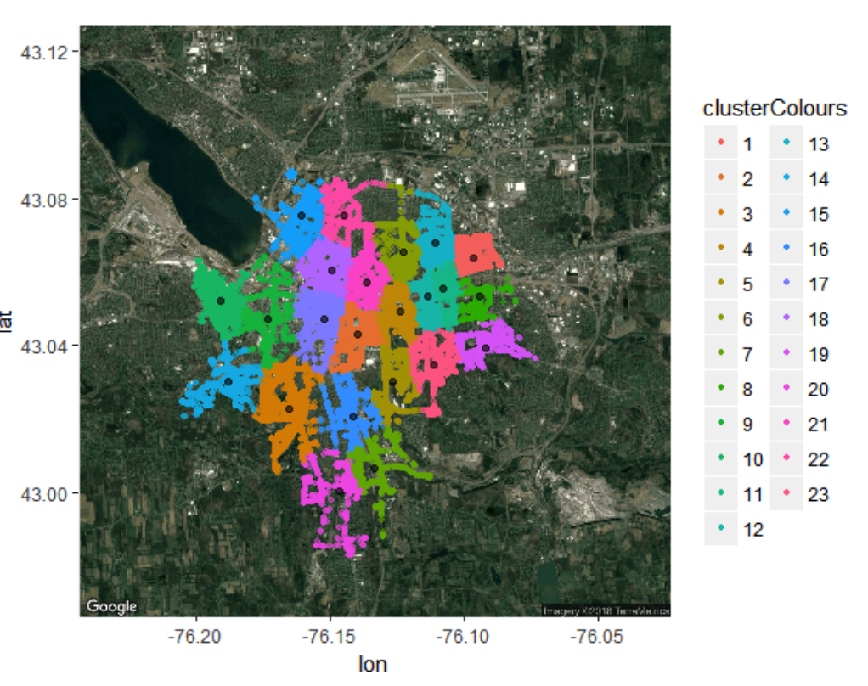
clusters we propose
23 areas = 23 trucks
*Number of clusters can be adjusted depending on the snow precipitation

